Slide 1

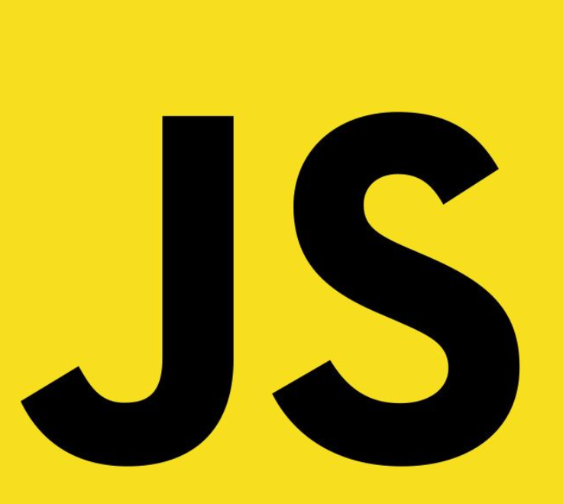
TypeScript

Slide 2


What is TypeScript ?
TypeScript is...
JavaScript with types

Slide 3

TypeScript ...
is a super-set of JavaScript
is a statically typed language
is compiled to JavaScript
is developed by Microsoft
is open source

Slide 4

Why Types ?
TypeScript's Type System...
Helps us find errors!
Analyzes our code as we type
Provides static typing
Supports object-oriented programming
Provides better code intelligence
Makes collaboration easier

Slide 5
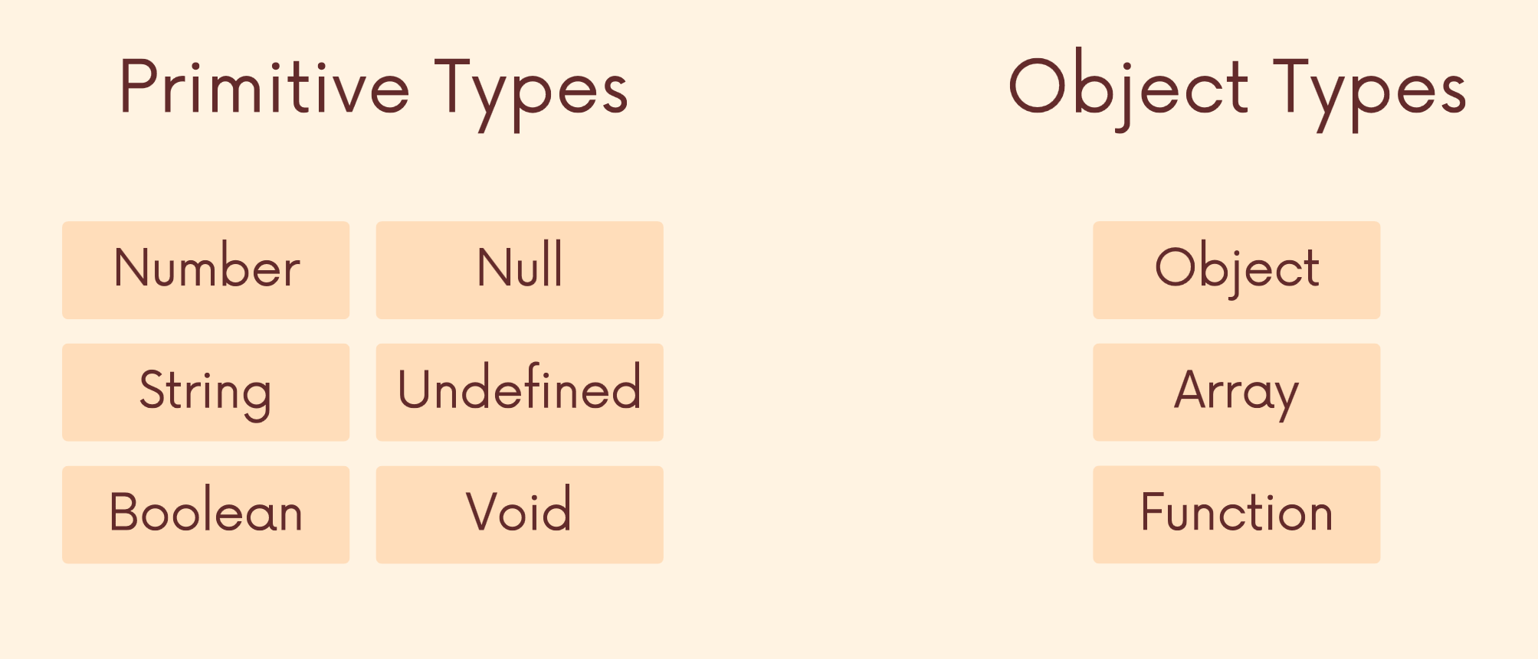
JavaScript

Slide 6
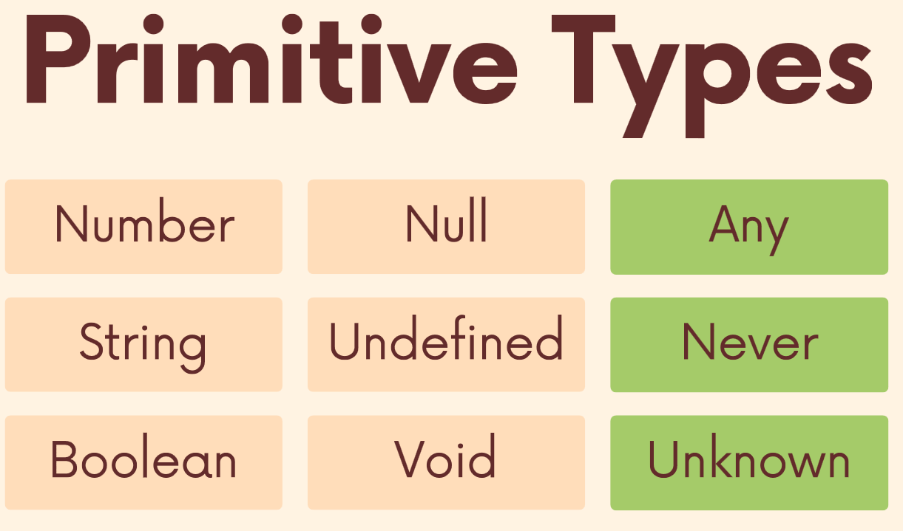
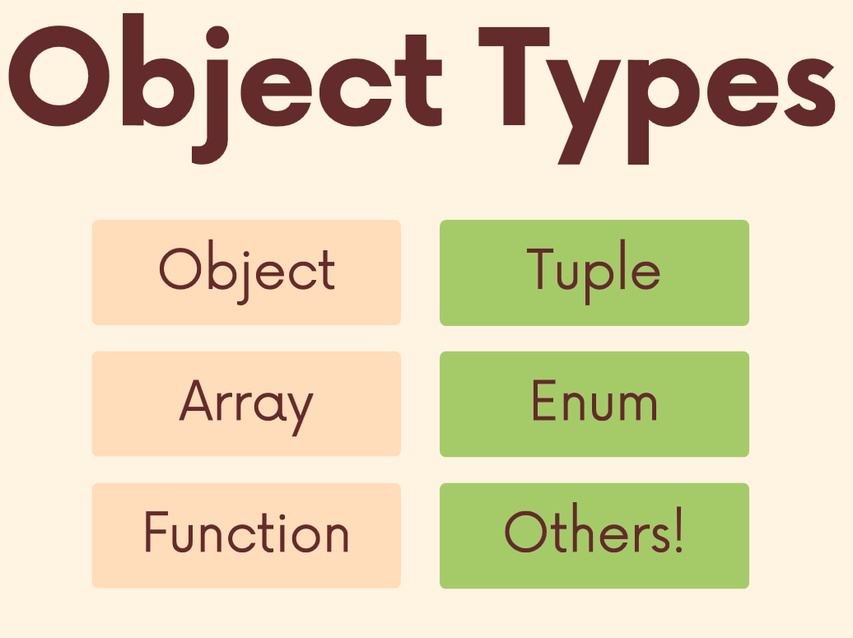
TypeScript

Slide 7

Statically Typed vs. Dynamically Typed
Statically Typed
The type of a variable is known at compile time. The compiler can detect type errors during compilation.
Type checking is performed at compile-time. Errors related to type mismatches are caught during compilation. Generally, requires more explicit type annotations.
Dynamically Typed
The type of a variable is known at runtime. Type errors can only be detected during runtime.
Type checking is performed at runtime. Errors related to type mismatches may only be discovered during program execution. Typically, allows more flexibility but may lead to runtime errors.

Slide 8

Types & Functions

Slide 9
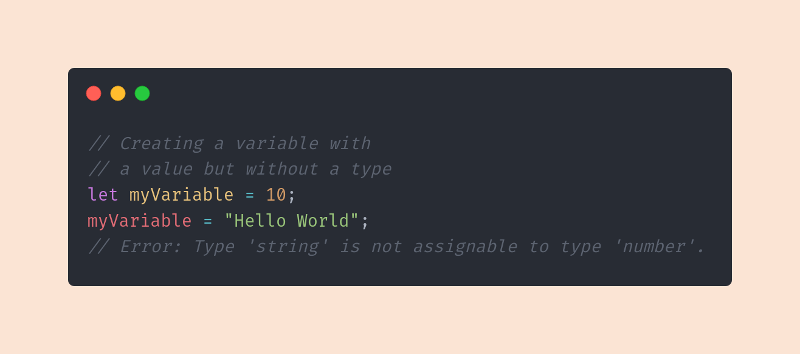
Type Inference
Type Inference refers to the Typescript
compiler's ability to infer types from certain
values in your code.
Typescript can remember a value's type
even if you didn't provide a type annotation,
and it will enforce that type moving forward.

Slide 10
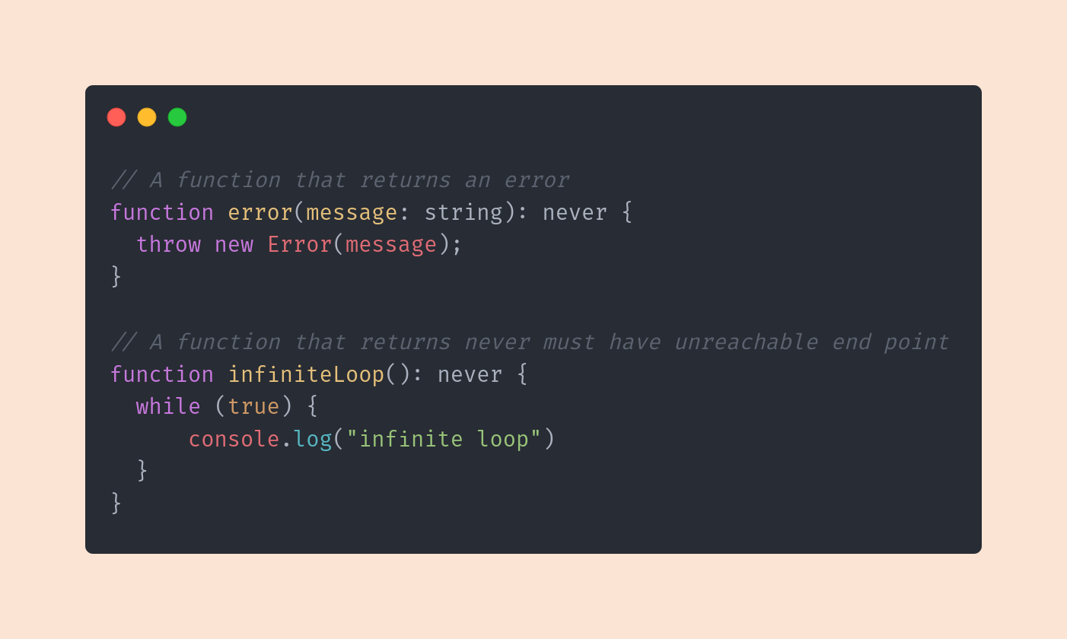
Never
The never type represents values that NEVER
occur. We might use it to annotate a function
that always throws an exception, or a
function that never finishes executing.
Don't confuse with void - void returns
undefined or null, which is technically still a
type of value. With never, a function doesn't
even finish executing.

Slide 11
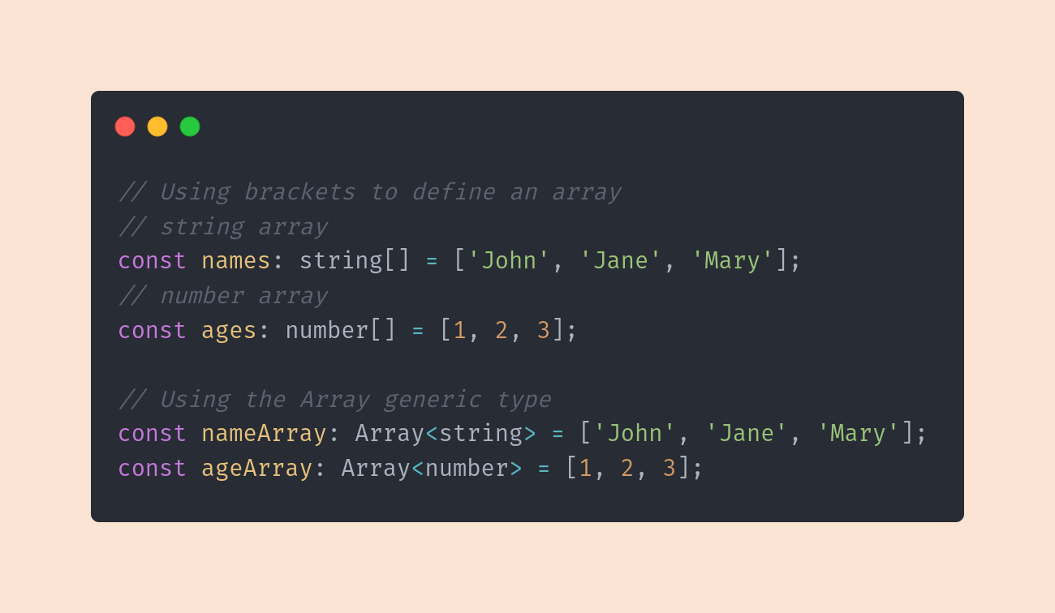

Array Types
Arrays can be typed using a type
annotation followed by empty array
brackets, like number[ ] for an array of
numbers.
Note: these arrays only allow data of
that one type inside them

Slide 12
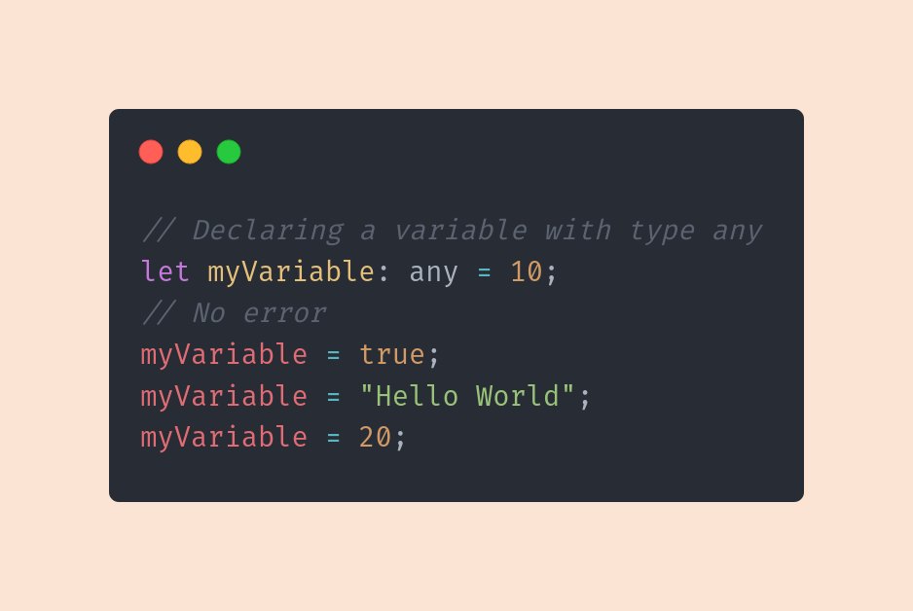
Any
'any' is an escape hatch! It turns
off type checking for this variable
so you can do your thing.
NOTE: it sort of defeats the
purpose of TS and types, so use it
sparingly!

Slide 13
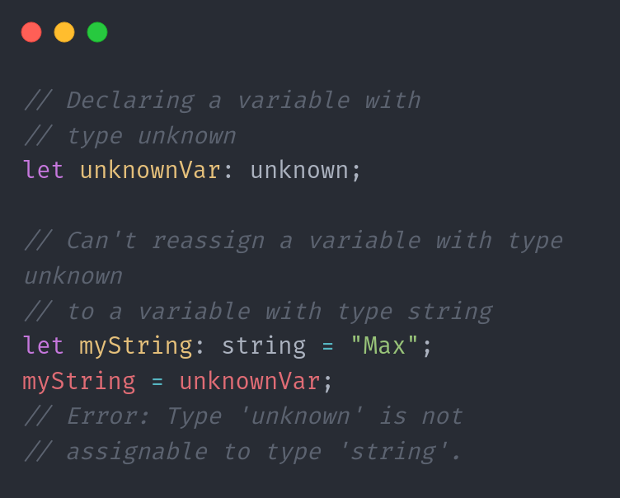

Unknown
Unknown is like a type-safe version of
any. Variables typed as unknown can
be assigned to values of any type.
However, variables with explicit types
can't be assigned to unknown without
using a type check first.

Slide 14
The Difference
Unknown: "I don't know"
You don't know what the value type is just yet, but
it's coming! To work with this variable, we'll do
type-checks so we only do certain things
depending on the type that comes back.
Any: “I don’t care”
Couldn't care less what type this variable is or
ends up being, for reasons Typescript won't
understand. Turn off type-checking and let's get
to work unobstructed.

Slide 15

Other Types

Slide 16
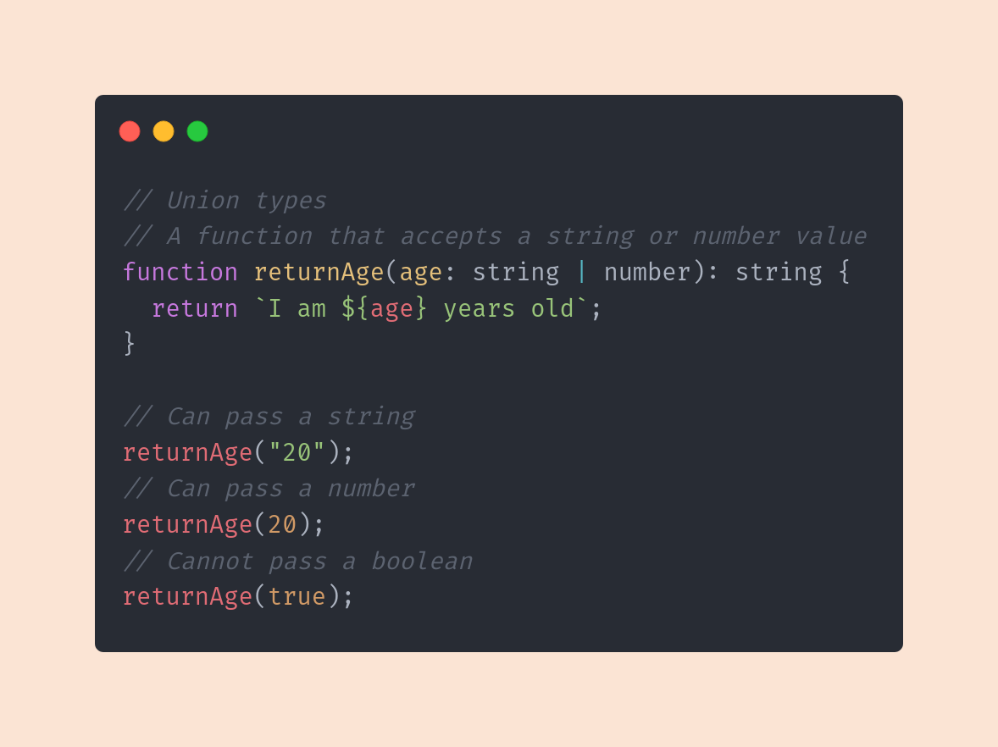

Union Types
Union types allow us to give a value a few
different possible types. If the eventual value's
type is included, Typescript will be happy.
We can create a union type by using the single
| (pipe character) to separate the types we want
to include. It's like saying, "This thing is allowed
to be this, this, or this". Typescript will enforce it
from there.

Slide 17
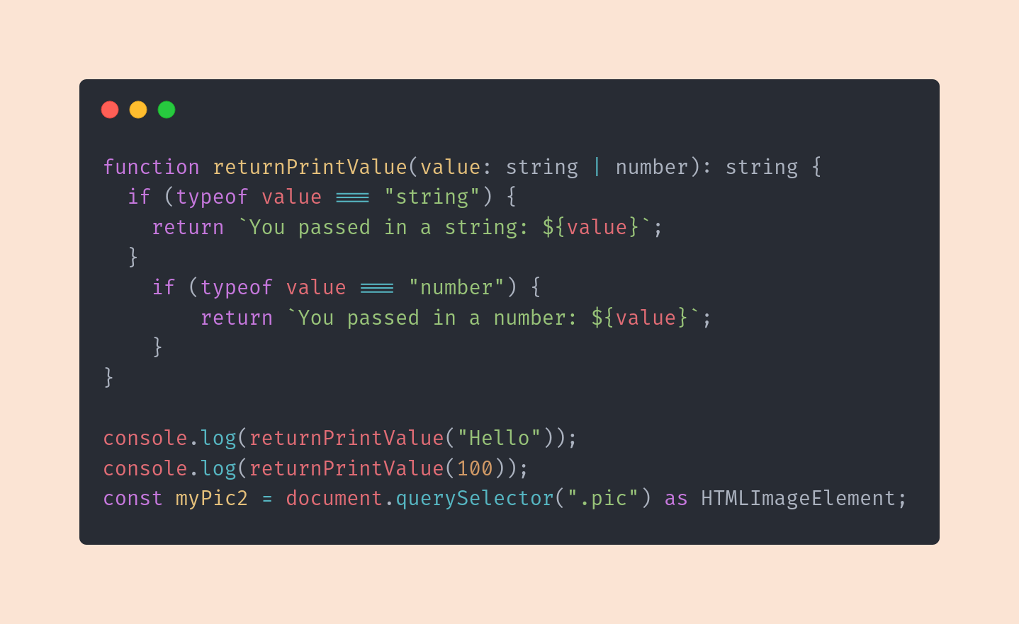

Unions - Narrowing the Type
Narrowing the Type is simply doing a type
check before working with a value. If your
value is a string you may want to use it
differently than if you got a number.
Since unions allow multiple types for a value,
it's good to check what came through
before working with it.

Slide 18
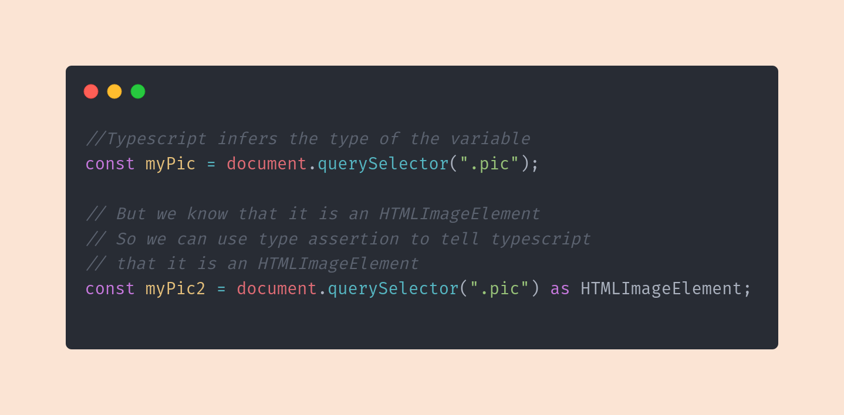

Type Assertions
Sometimes you might have more specific information about a value's
type, and you want to make sure Typescript knows it too.
You can assert a value's type by using the 'as' keyword, followed by the
specific type you want to assert.

Slide 19
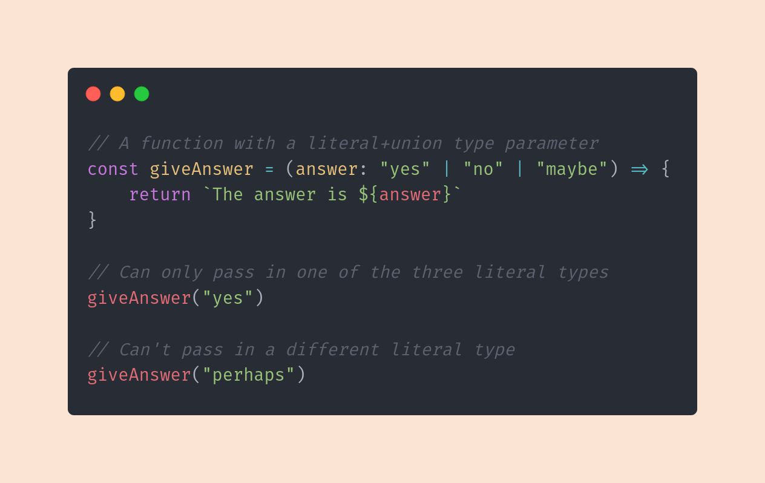

Literal Types
Literal types are not just types - but
the values themselves too!
On it's own, they may not seem useful,
but combine them with unions and you
can have very fine-tuned type options
for Typescript to enforce.

Slide 20
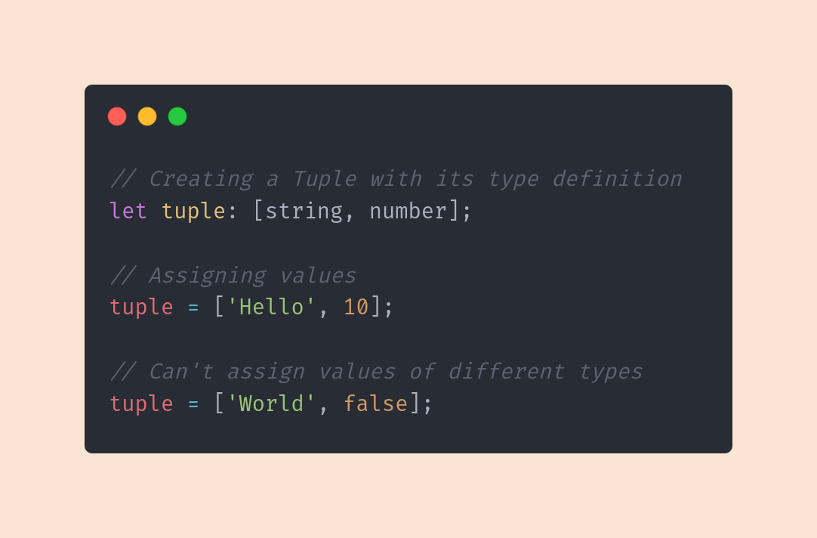

Tuples
Tuples are a special type exclusive to
TypeScript (they don't exist in JS)
Tuples are arrays of fixed lengths and ordered
with specific types - like super rigid arrays.

Slide 21
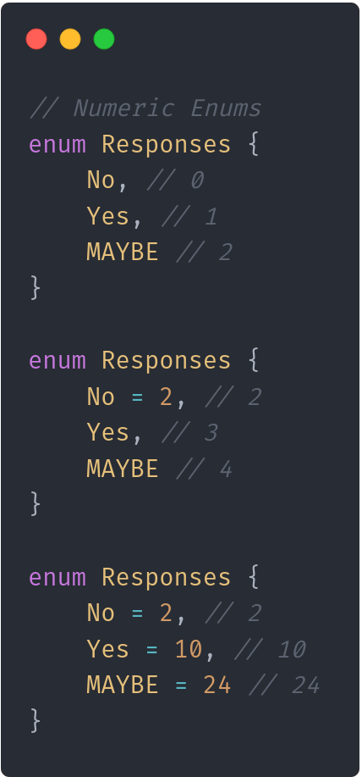
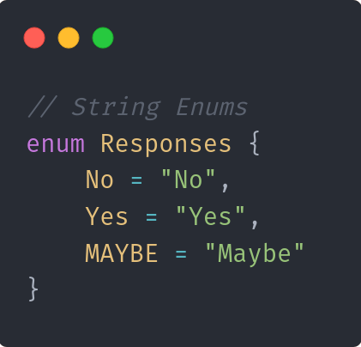
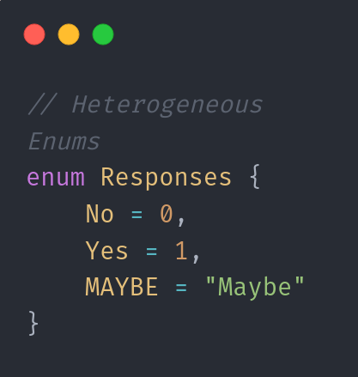
Enums
Enums allow us to define a set of named constants.
We can give these constants
numeric or string values.
There's quite a few options when it
comes to enums!

Slide 22

Aliases & Interfaces

Slide 23
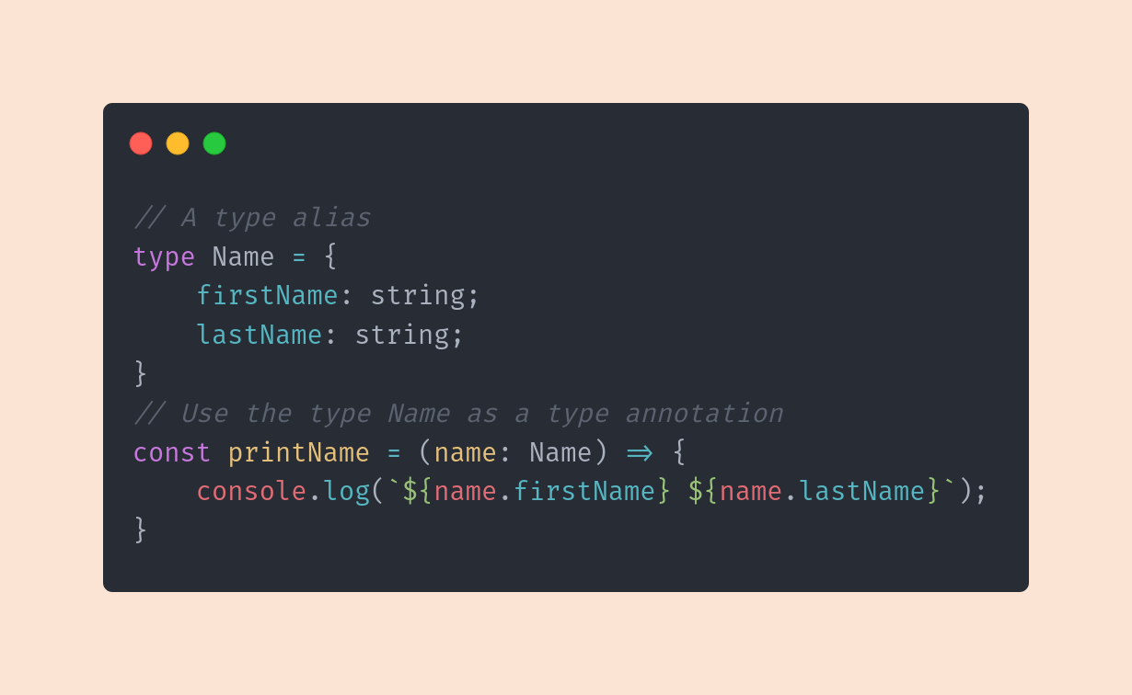
Type Alias
Instead of writing out object types in an
annotation, we can declare them
separately in a type alias, which is
simply the desired shape of the object.
This allows us to make our code more
readable and even reuse the types
elsewhere in our code.

Slide 24
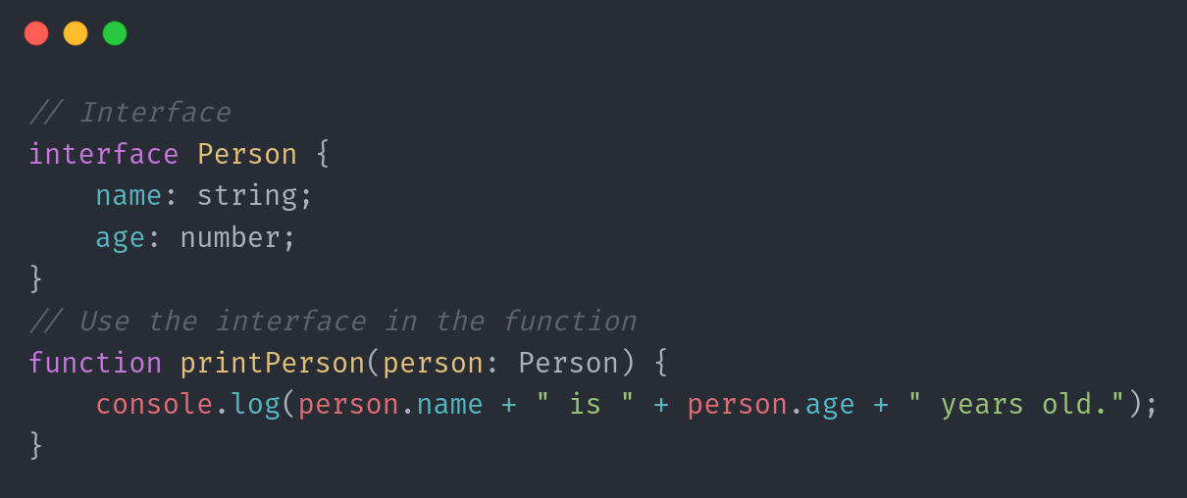
Interfaces
Interfaces serve almost the exact
same purpose as type aliases
(with a slightly different syntax).
We can use them to create
reusable, modular types that
describe the shapes of objects

Slide 25

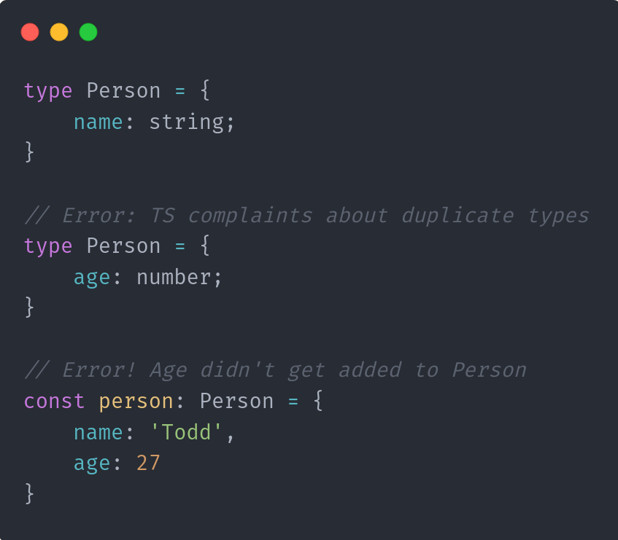
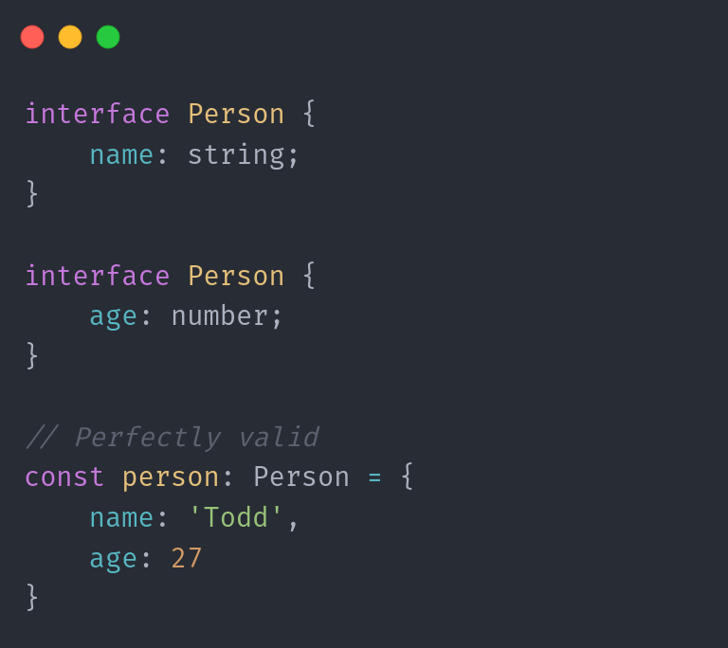
Types vs. Interfaces Adding new properties
Types
Interfaces

Slide 26
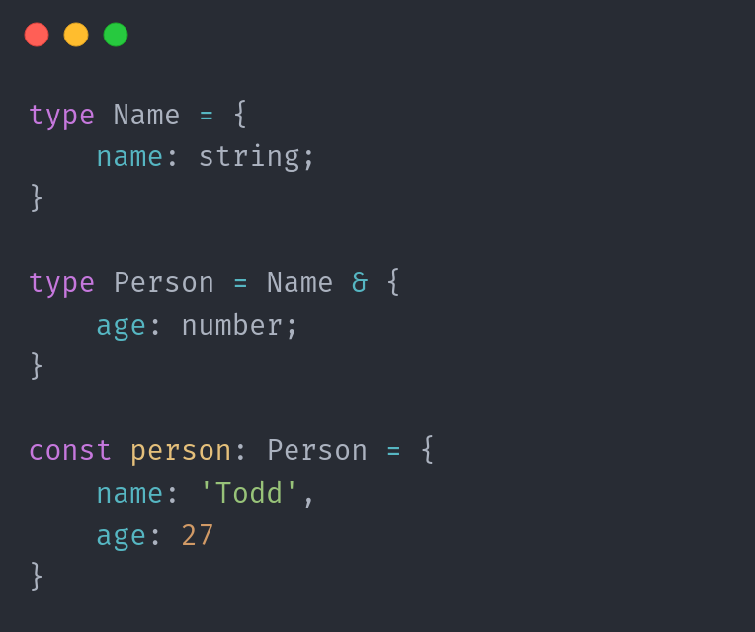
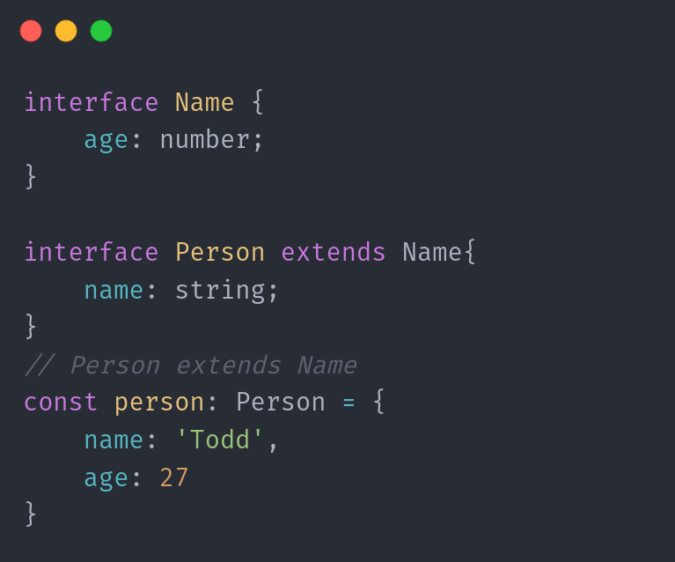
Types vs. Interfaces Extending Properties
Types
Interfaces

Slide 27
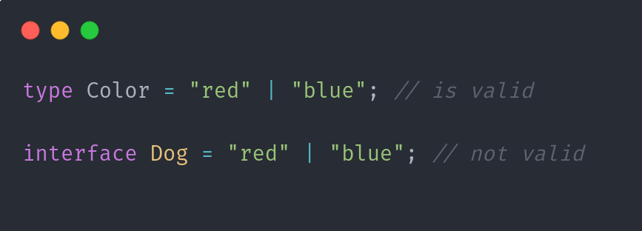
Types vs. Interfaces Declaring Properties

Slide 28

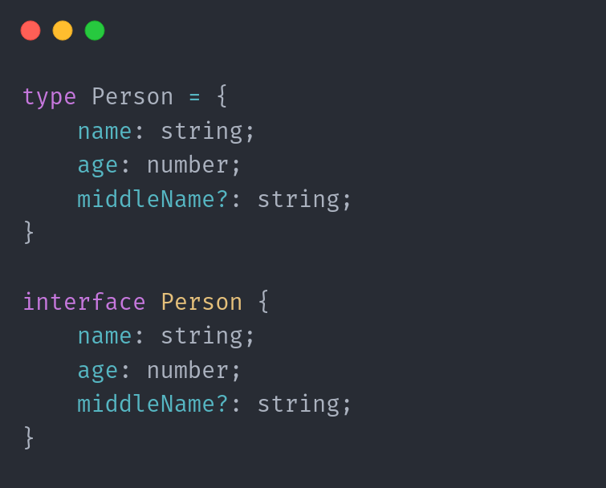
Types vs. Interfaces Optional Properties

Slide 29

Type Narrowing

Slide 30
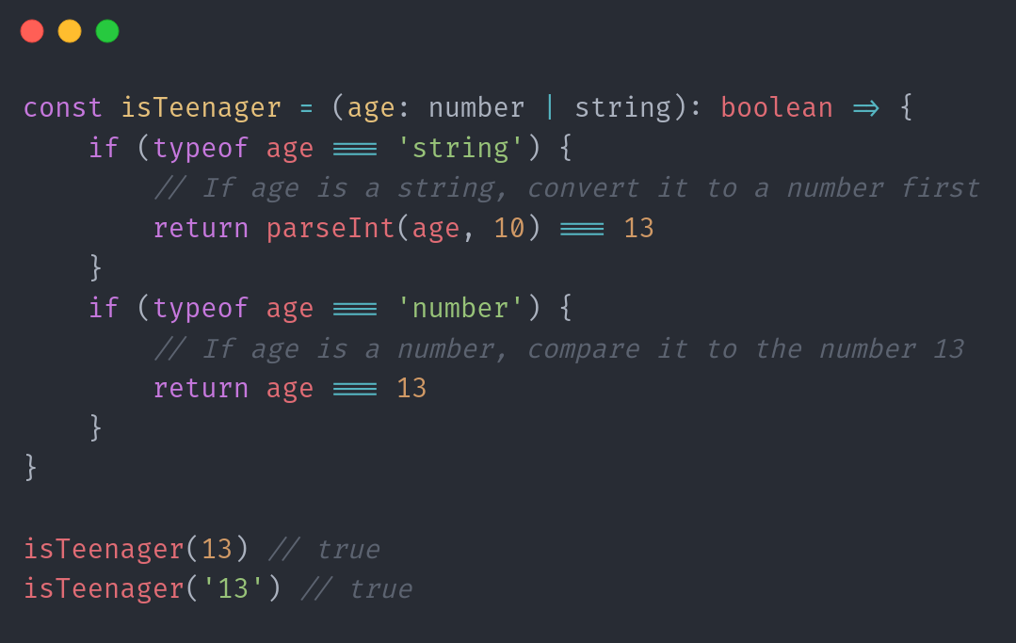
Typeof Guards
typeof Type Guards involve simply doing a
type check before working with a value.
Since unions allow multiple types for a value,
we can first check what came through
before working with it

Slide 31
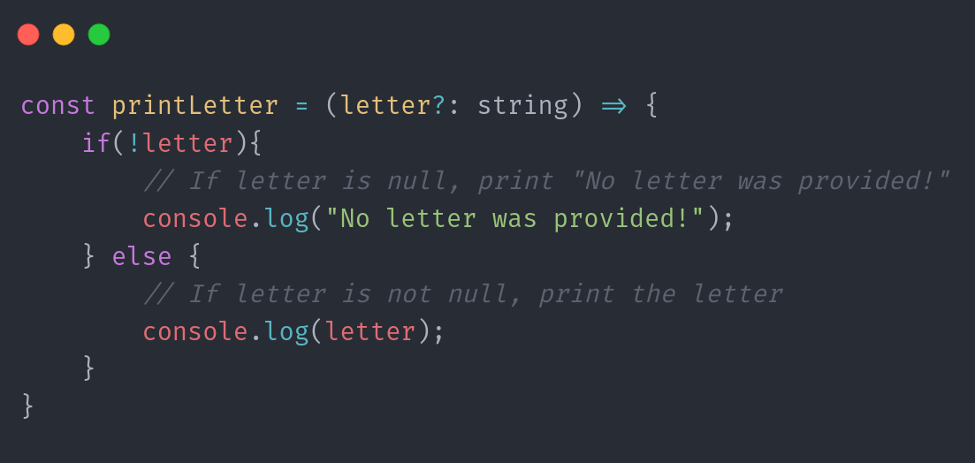

Truthiness Guards
Truthiness Type Guards involve
checking a value for being truthy or
falsy before working with it.
This is helpful in avoiding errors when
values might be null or undefined.

Slide 32
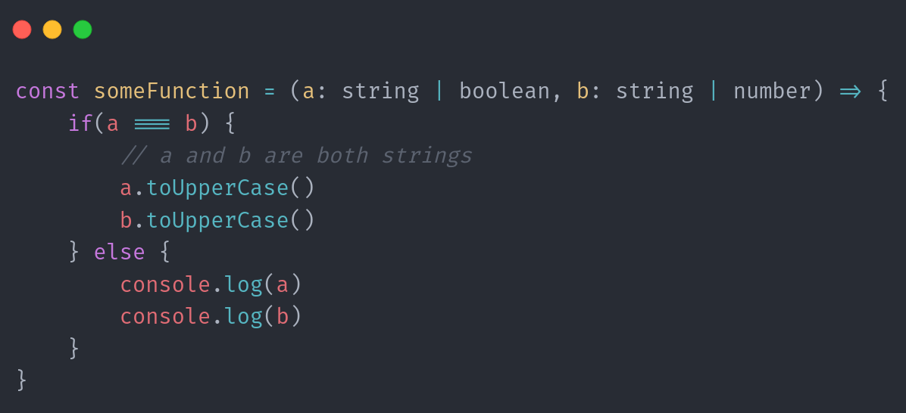

Equality Narrowing
equality Type Guards involve
comparing types to each other
before doing certain operations with
values.
By checking two values against one
another, we can be sure they're both
the same before working with them in
a type-specific way.

Slide 33
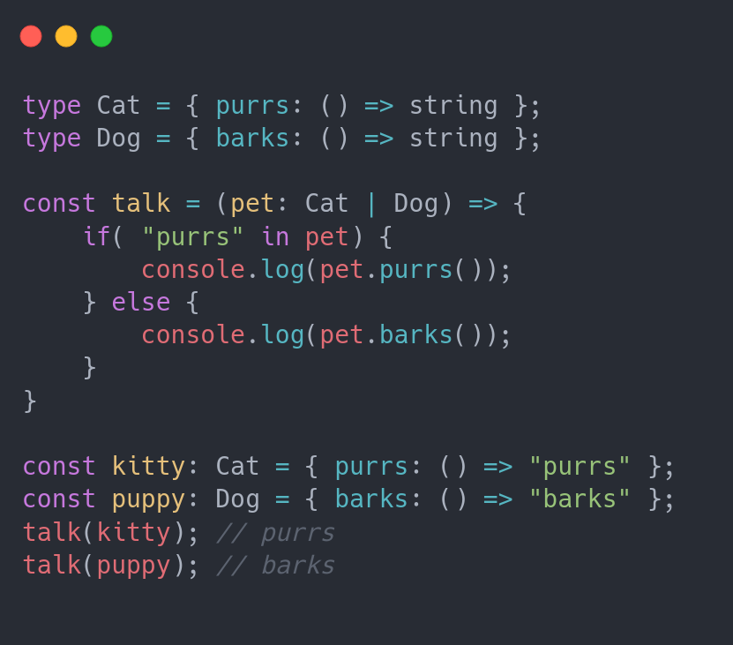

in Operator Narrowing
JavaScript's in operator helps check if
a certain property exists in an object.
This means we can use it to check if a
value exists in an object, according to
its type alias or aliases, before
working with it

Slide 34
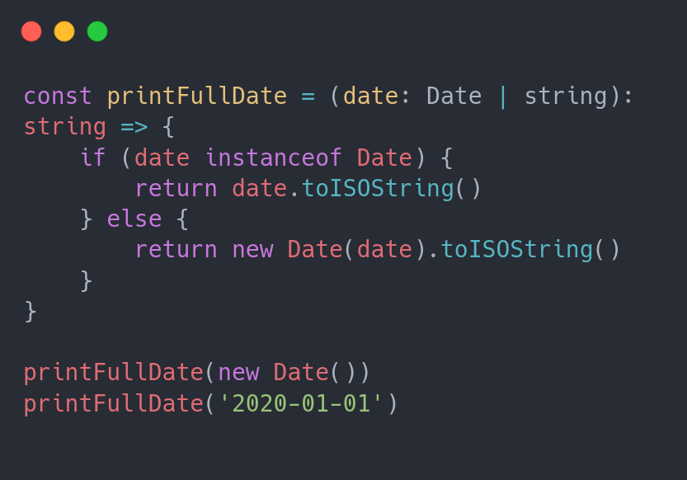
instanceof Narrowing
instanceof is a JavaScript operator that
allows us to check if one thing is an instance
of another (remember prototypes?).
This can help us narrow types when working
with things like classes.

Slide 35
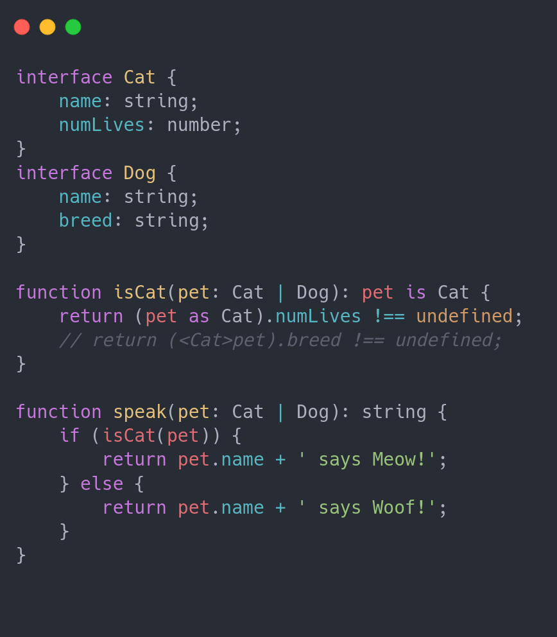
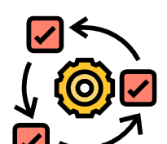
Type Predicates
Typescript allows us to write
custom functions that can
narrow the type of a value.
These functions have a very
special return type called
a type predicate.
A predicate takes the form
parameterName is Type

Slide 36
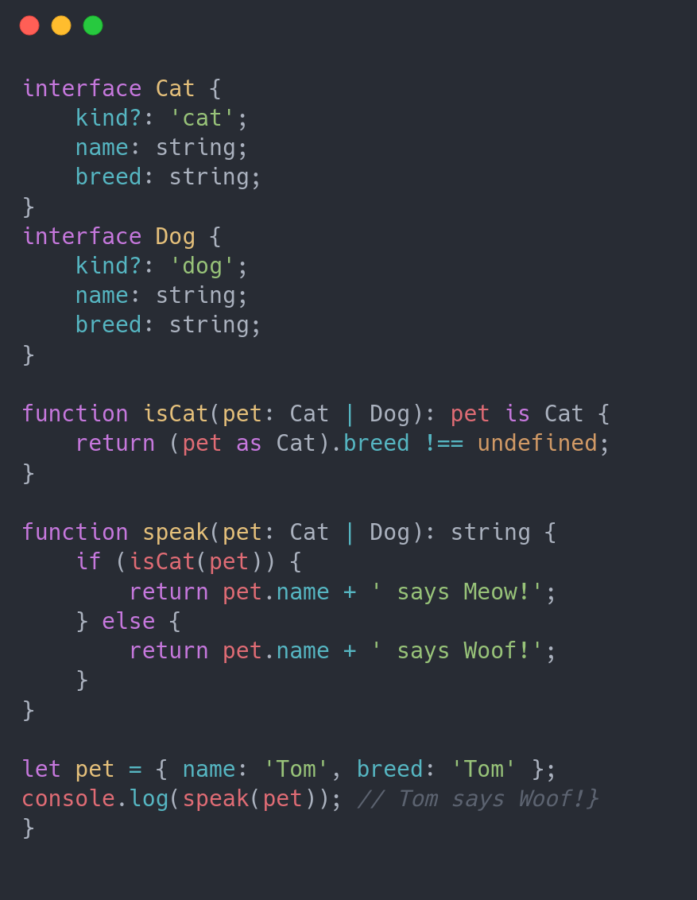

discriminated unions
A common pattern in Typescript involves
creating a literal property that is common
across multiple types.
We can then narrow the type using that
literal property

Slide 37

{ Objects } Types

Slide 38
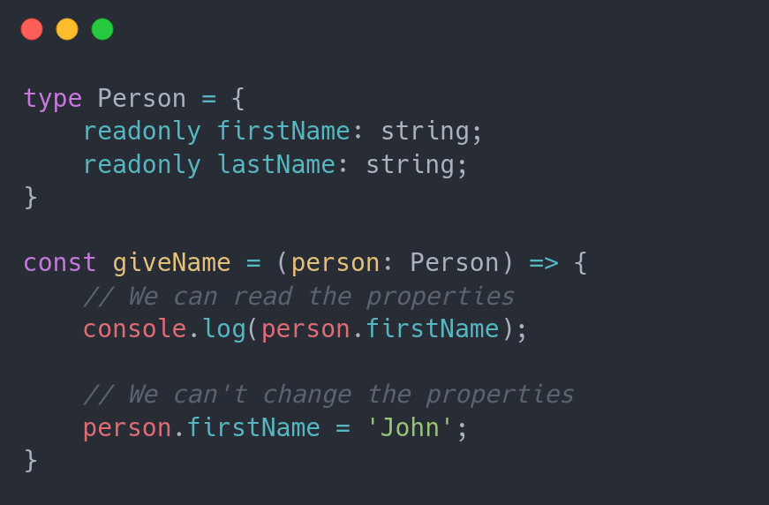

readonly Properties
Adding the readonly keyword before
a type assignment locks that value
down after everything compiles. In
other words, you can set it but you
can't reassign it!
Works in both type aliases &
interfaces!

Slide 39
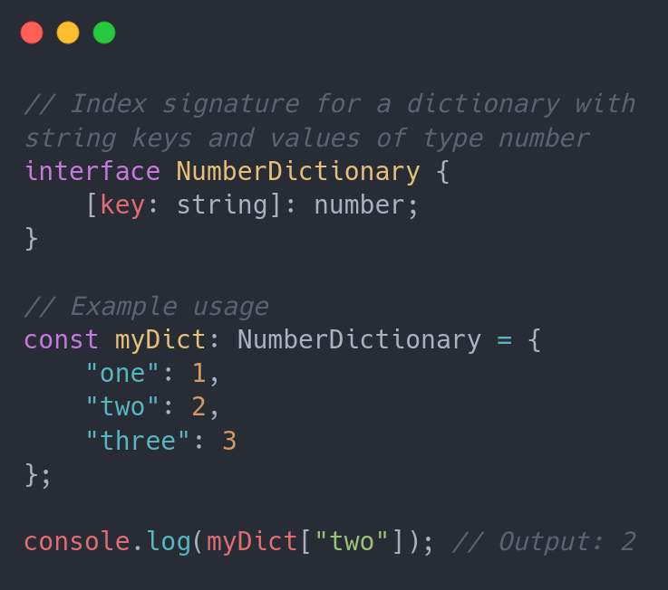
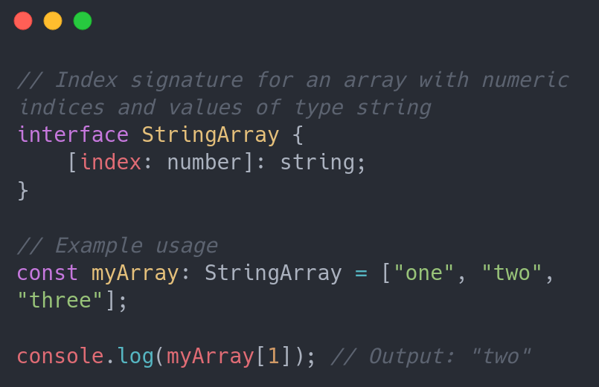

Index Signature
In TypeScript, an index signature allows you to define a type where you can use an index (usually a string or a number) to access properties that are not explicitly defined in the type.
It's a way to represent dictionaries or objects with dynamic keys.
Index signatures are often used when you want to work with objects that can have arbitrary property names.

Slide 40
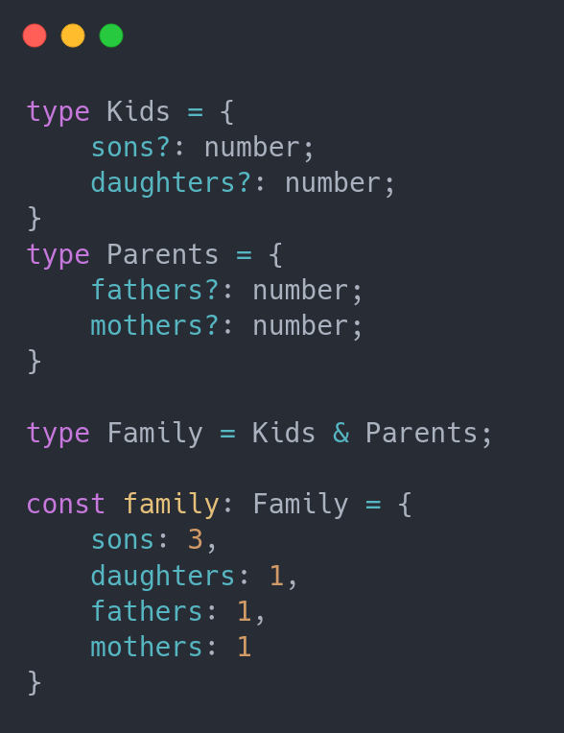

Intersection Types
Intersections can be created using type
aliases, combining two object types
together.
This is a nice way to create new types from
existing types, or add new types to existing
types.

Slide 41
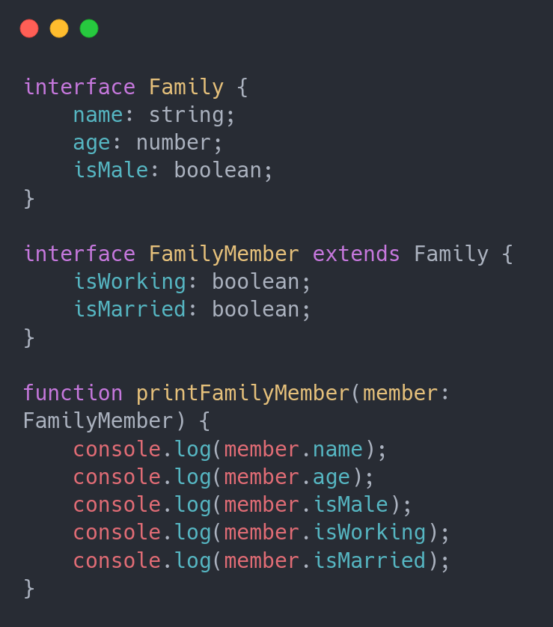

Extending Types
Got an interface of types? You can
extend it into a new interface, adding
the old types to the newly declared
ones.
This is helpful if you want to add types
to an existing object type.

Slide 42

Generics

Slide 43
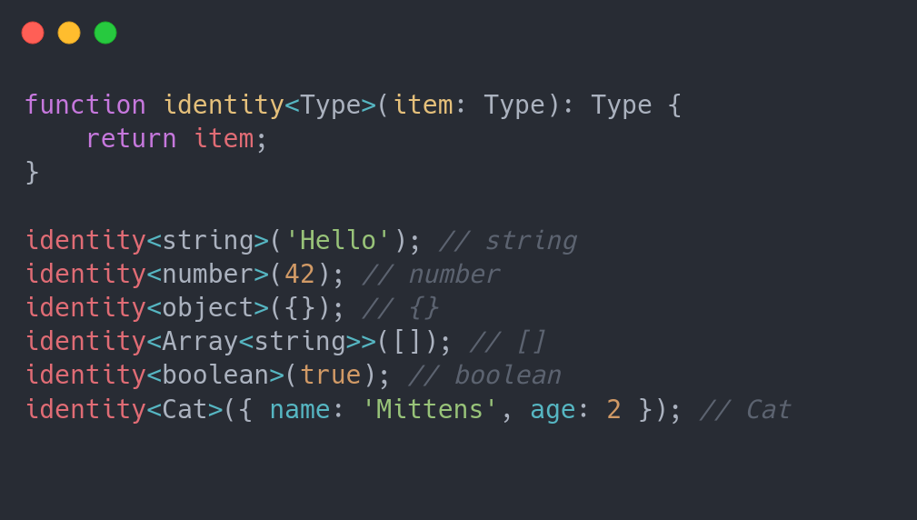
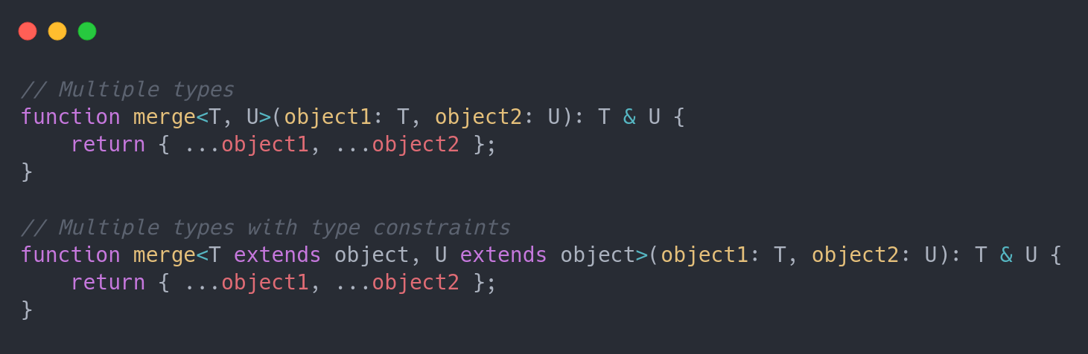
Generics
Generics allow us to define reusable functions and classes that work with multiple types rather than a single type.

